Slide 1
Car_Dataset_Analysis
Author: S. Manoj Kumar
Academic Institution: Malla Reddy University
Date: October 2025

Slide 2
Introduction
This project explores the Cars Dataset to gain insights into various car features such as mileage, horsepower, price, and engine specifications. The objective is to perform data analysis and visualization to understand trends and relationships among variables.

Slide 3
Data Loading & Exploration
The dataset was loaded using Python libraries like pandas and numpy. Initial exploration included checking data types, structure, and summary statistics to understand the dataset composition and identify potential issues such as missing values.

Slide 4
Data Cleaning & Preprocessing
Data cleaning involved handling missing values, removing duplicates, and converting data types where necessary. Preprocessing steps included normalization, encoding categorical variables, and ensuring consistency in feature representation.

Slide 5
Data Visualization
Data visualization techniques were used to identify trends, patterns, and correlations. Libraries such as matplotlib and seaborn were used to create histograms, scatter plots, and boxplots to better understand distributions and relationships.

Slide 6
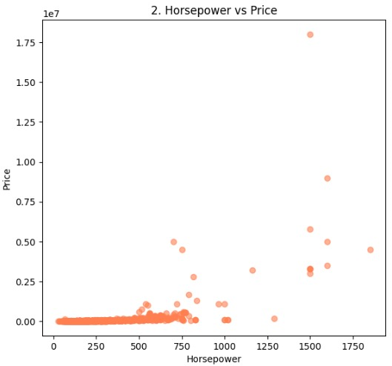
Sample Graphs
Sample graphs include:
- Horsepower vs Mileage scatter plot

Slide 7
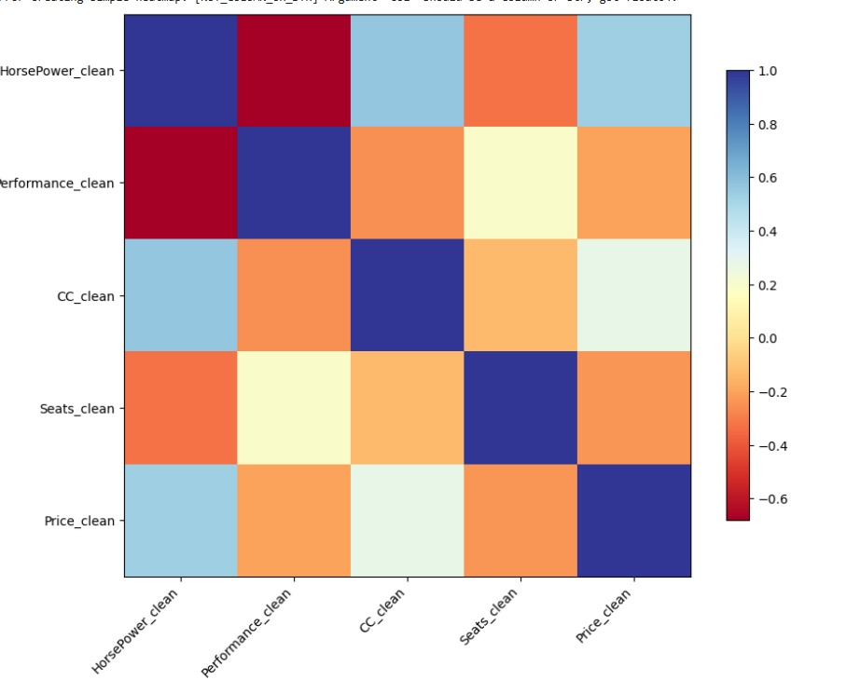
Correlation heatmap of numerical variables

Slide 8
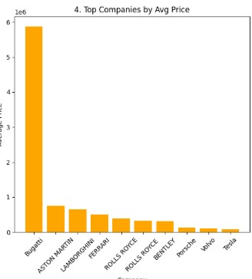
Top Companies by Average Price

Slide 9
Example Visualizations
Example visualizations demonstrate relationships between key performance indicators such as price, mileage, and horsepower. Visuals helped in identifying outliers and high-performance vehicles with optimal efficiency.

Slide 10
Conclusion
The analysis concludes that certain features like horsepower, mileage, and brand have a significant impact on car pricing. Visualizations provide a clear understanding of feature influence on overall performance metrics.

Slide 11
Thank you

